Slide 1
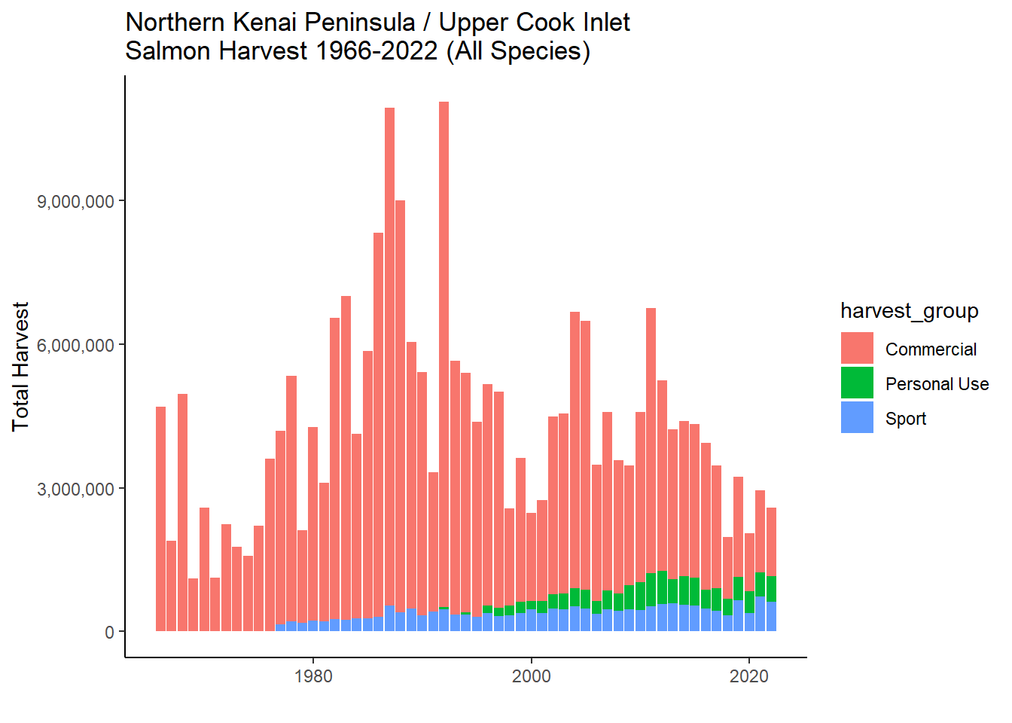
Data sources: Alaska Dept. of Fish and Game; assembled by Rivulet Research © 2024. Draft figure not for public distribution.

